Slide 1


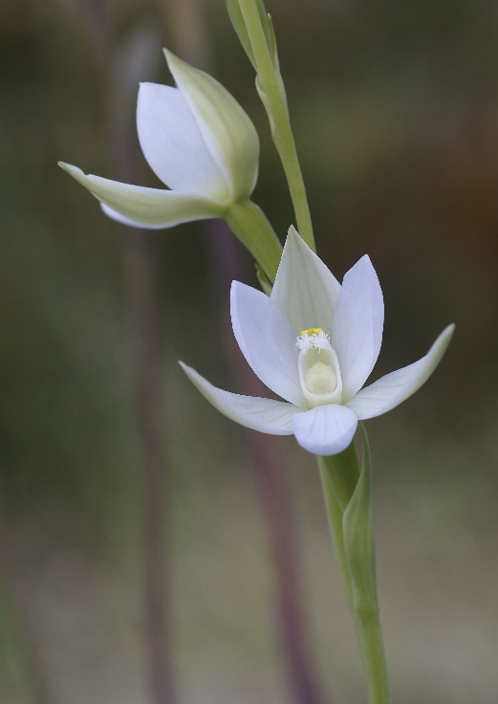

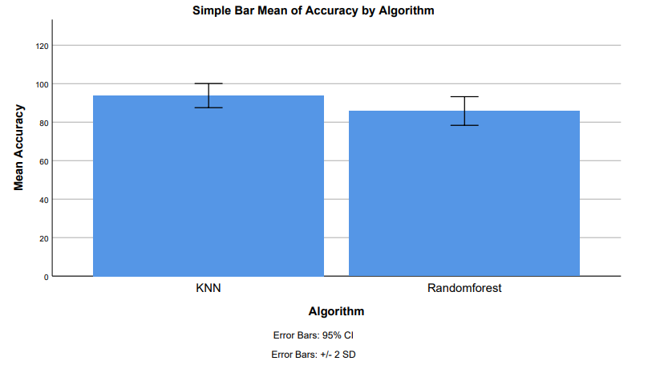
Name: V Anil Kumar Yadav Register Number: 192110198
Guided by Dr. M Rajasekar
Ms. Poorani.S
Guided by Dr. Mary Valantina. G
A Comparative Analysis of Sword lily Petal Features using K Nearest Neighbor with K dimensional Tree and Random Forest Algorithms to Improve the Accuracy of Classification.
INTRODUCTION
Types of Sword lily
The study to classify different species of sword lilies, scientifically known as Gladiolus, and analyze their patterns.
Sword lilies, prized for their aesthetic appeal, economic value, and cultural significance, contribute to industries such as horticulture, floristry, and pharmaceuticals, while also playing a role in ceremonies and biodiversity conservation.
Sword lilies serve as valuable assets in various fields like botany, genetics, and horticulture, with applications spanning research, industry, and cultural practices.
The study compares the classification accuracy of sword lily species using the K Nearest Neighbor algorithm with Random Forest over a decade of research, with significant numbers of related papers found in ResearchGate, IEEE Xplore, and Google Scholar.
The primary issues addressed in this research include identifying species parameters like sepal and petal dimensions and classifying the species accurately.
The paper proposes the use of the K Nearest Neighbor algorithm with K dimensional tree for species differentiation, offering potential benefits for future researchers as a reference in species classification.
The overarching goal of the paper is to enhance the accuracy rate in classifying sword lily species, contributing to advancements in botanical research and potentially benefiting various industries and cultural practices.
MATERIALS AND METHODS
Implementation of KNN
Model Evaluation
Data Collection
Data Preprocessing
Feature Selection
Model Selection
Implement the KNN algorithm using appropriate libraries or code frameworks.
Evaluate the performance of both KNN with K Dimensional Tree and Random Forest models using metrics such as accuracy, precision, recall, F1-score, and confusion matrix
Obtain sword lily petal feature data from reliable sources or through fieldwork.
Ensure the dataset includes a variety of sword lily species with labeled petal features
Clean the dataset by handling missing values and outliers.
Normalize or standardize the data to ensure fair comparisons between feature
Employ techniques such as correlation analysis or domain knowledge to select relevant petal features for classification.
Choose the K Nearest Neighbor (KNN) algorithm, K-dimensional Tree, and Random Forest for comparative analysis.
Implementation of Random Forest
Result of Analysis
Implement the Random Forest algorithm using ensemble learning techniques.
Draw conclusions regarding the effectiveness of the KNN with K Dimensional Tree and Naive Bayes techniques in accurately classifying sword lily petal features
RESULTS
K Nearest Neighbor v/s Random Forest
K Nearest Neighbor Algorithm has highest accuracy 92.40% when compared with the Accuracy of Random Forest Algorithm 85.80%.
The standard deviation of K Nearest Neighbor Algorithm and Random Forest Algorithm are 3.139 and 3.722 respectively.
The standard error mean of K Nearest Neighbor Algorithm and Random forest Algorithm are 0.702 and 0.832 respectively.
These results that K Nearest Neighbor algorithm is best for these research of classification of Sword lily.
Group Statistics table 1
 |  | Levene's test for equality of variances | T- test for equality of means
 |  |  |  |  |  |  |  |  | 95% confidence interval of the difference
 |  | F | Sig. | t | df | Sig. (2-tailed) | Mean difference | Std. Error difference | Lower | Upper
Accuracy | Equal variances assumed Equal variances not assumed | 0.319 | 0.576 | 7.348 | 38 | 0.032 | 8.102 | 1.089 | 5.796 | 10.204
 | Equal variances assumed Equal variances not assumed |  |  | 7.348 | 36.948 | 0.032 | 8.102 | 1.089 | 5.794 | 10.206
 | Algorithm | N | Mean | St. Deviation | Std.Error Mean
Accuracy | K Nearest Neighbor | 20 | 92.40 | 3.139 | 0.702
 | Random Forest | 20 | 85.80 | 3.722 | 0.832
Independent sample table
The shown groups in the X-axis are the K Nearest Neighbor algorithm vs Random Forest Algorithm and the Y-axis mean accuracy of detection ± 2 standard deviations.
finding the accuracy of the two algorithms, the mean accuracy of K Nearest Neighbor is 92.05% better than the Random Forest 85.80% and St. Deviation is slightly lower than the Random Forest.
DISCUSSION AND CONCLUSION
K Nearest Neighbor (KNN) algorithm achieved a higher accuracy of 92.40% compared to Random Forest algorithm's 85.80% in classifying Sword lily species with the training dataset.
The observed difference in accuracy between the two algorithms is statistically significant (p<0.05), indicating that KNN outperforms Random Forest according to an independent test.
Iwendi, Boulouard, and Kryvinska proposed an efficient Neuro-Fuzzy Approach for Sword lily species classification, emphasizing supervised learning methods' performance evaluation.
Dwork and Roth also contributed to the classification of Sword lily species using machine learning techniques, though specific methodologies were not detailed.
The study by Prof. Joylin Priya Pinto and Prof. Jyothi Shetty is considered exemplary in the field, employing neural networks for accurate classification of Sword lily species based on various parameters, with no contradictory findings.
Random Forest algorithm exhibits limitations such as performance degradation with imbalanced datasets, susceptibility to overfitting with noisy or irrelevant features, computational expense for large datasets, and potential struggle with extrapolation.
Interpreting the decision-making process of Random Forest models can be challenging due to their complexity, contrasting with simpler models like decision trees.
Careful preprocessing and consideration of these limitations are crucial when deploying Random Forest algorithms in real-world applications to ensure optimal performance and interpretability.
BIBLIOGRAPHY
Iwendi, Celestine, Zakaria Boulouard, and Natalia Kryvinska. 2023. Proceedings of ICACTCE’23 — The International Conference on Advances in Communication Technology and Computer Engineering: New Artificial Intelligence and the Internet of Things Based Perspective and Solutions. Springer Nature.
Anushee Jain, Chandrasekharan Rajendran, "A Novel Linear Mathematical Model Based Heuristic for a Class of Classification Problem with Non-linearly Separable Data", Applications of Emerging Technologies and AI/ML Algorithms, pp.247, 2023.
Abu-Bader, Soleman H., and Professor and Chair of Research Sequence at the School of Social Work Soleman H Abu-Bader. 2021. Using Statistical Methods in Social Science Research: With a Complete SPSS Guide. Oxford University Press, USA.
Preisach, Christine, Hans Burkhardt, Lars Schmidt-Thieme, and Reinhold Decker. 2008. Data Analysis, Machine Learning and Applications: Proceedings of the 31st Annual Conference of the Gesellschaft Für Klassifikation
Goldstein, Diane, Sylvia Grider, and Jeannie Banks Thomas. 2007. Haunting Experiences: Ghosts in Contemporary Folklore. University Press of Colorado.
Galvin, Kathleen A., Robin S. Reid, Roy H. Behnke Jr, and N. Thompson Hobbs. 2007. Fragmentation in Semi-Arid and Arid Landscapes: Consequences for Human and Natural Systems. Springer Science & Business Media.

